Slide 1

Mini Project Face Recognition Attendance System
Batch-16
Guide :
Mrs. Ragini Patil
Team Members :
B Mahesh 20R21A0566
M Adarsh 20R21A0590
Md Musharruf 20R21A0598
N Dhanush 20R21A0599
N Durga sai 20R21A05A0

Slide 2


INTRODUCTION :
Traditional attendance is Mark manually by teachers and they must make sure correct attendance is marked for respect to student.
This whole process waste some of lecture time and part of current information is missed due to fraudulent and proxy cases.

Slide 3
Abstract :
We are living in a world where everything is automated and linked online. The internet of things, image processing, and machine learning are evolving day by day. Many systems have been completely changed due to this evolve to achieve more accurate results. The attendance system is a typical example of this transition, starting from the traditional signature on a paper sheet to face recognition. This Project proposes a method of developing a comprehensive embedded class attendance system using facial recognition with showing whether the face of the person is the student for that specified class or not. The system is based on the machine learning algorithm which is to be implemented on python language and using computer/laptop camera for the input image of the students or a normal outer camera can also be used which has to be connected to the system which is programmed to handle the face recognition by implementing the Local Binary Patterns algorithm LBPs.

Slide 4
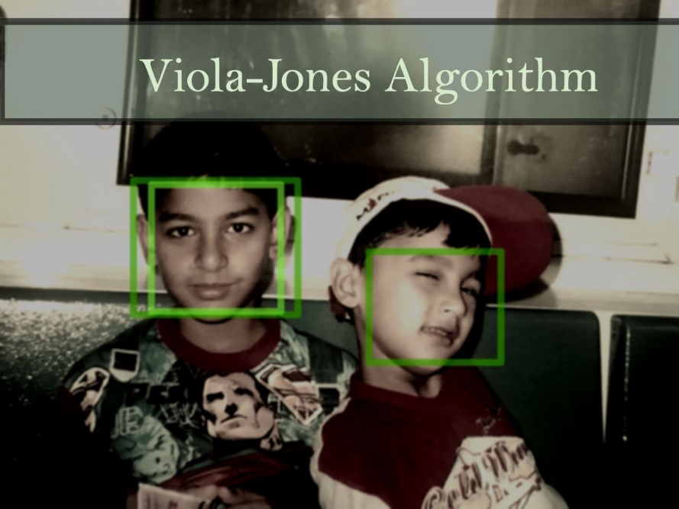
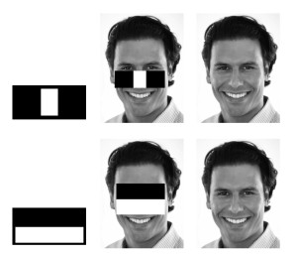
Existing System :
In the last twenty years, the computer-based facial recognition field has expanded rapidly. Several algorithms have been introduced and improved to the point where computers can rival humans in accuracy of facial recognition.
one of the algorithm used in face recognition is viola jones.Viola-Jones algorithm is a machine-learning technique for object detection. first detect smaller features of a human face in that image and if all of those features are found then the algorithm predicts that there is a face in that image or sub-image

Slide 5
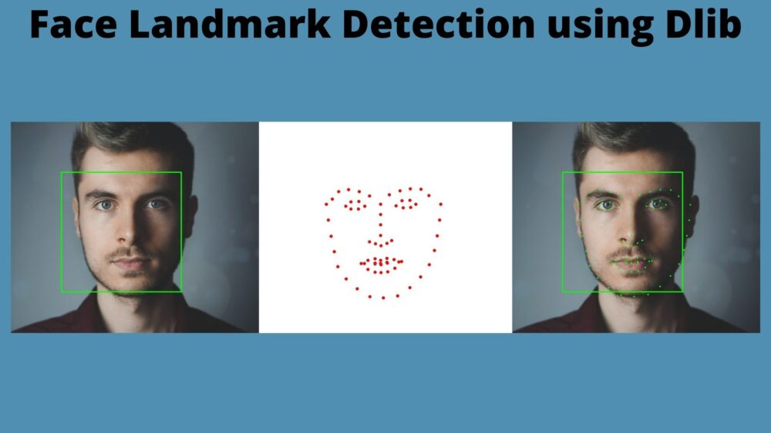
Proposed System :
The proposed methodology starts with the registration of students into the system. Following methodology has few main stages such as capturing images, pre-processing of the images, Haar Cascade classifier is used for face detection, developing a dataset of images, the further process of face recognition is done with the help of LBPH algorithm.
In our proposing system we are using opencv and dlib.
In our project we use new Machine learning algorithm like CNN (Convolutional Neural Network).
Algorithm 1: OpenCV Haar Cascade Face Detection.
Algorithm 2: Dlib HoG Face Detection.

Slide 6
Literature Survey :
EXISTIG SYSTEM | FEATURES | BENEFITS | LIMITATIONS
Automated attendance management system using face recognition. | Use Eigen Faces for Recognition | Low accuracy | Multiple faces not recognized
Face recognition system by nevon | Stores the faces that are detected and automatically marks attendance | Used for security purposes in organizations | Does not recognize properly in poor light
Student attendance system in classroom using fac recognition technique | Face detection, preprocessing, feature extraction and classification stages | Medium accuracy | Requires high definition camera and masked faces were not recognized

Slide 7
ANALYSIS OF IDENTIFIED PROBLEM :
Taking and tracking students’ attendance manually, losing attendance sheets, dishonesty, wasted time and high error scales are problems facing the lecturers use the existing attendance system.
It is a hard process, take time and cause a lot of paper-based work. As a result, in order to solve these problems and avoid errors we suggest to computerize this process by providing a system that record and manage students’ attendance automatically without needing to lecturers’ interference.
In the existing systems we may observed that we requires high definition camera , and also it doesn’t recognize the students in poor light . masked faces were not recognized .

Slide 8
Functional Requirements :
A user must be able to manage student records.
Only an authorized user must be able to use the system.
System must be attached to wireless camera and face recognition should be smooth.
It should be able to handle 'gif' and 'jpeg’ images.
Face detection.
Face recognition.
Extracts the eye features efficiently.

Slide 9
Non-Functional Requirements :
The GUI of the system will be user friendly.
The data Will be shown to the user will be made sure that it is correct and it is available for the time being.
System will be flexible to change.
This system will be extended for the change and to the latest technologies.
Efficiency and effectiveness of the system will be made sure.
Performance of the system will be made sure.
The system should perform its process with accuracy and precision to avoid problems

Slide 10
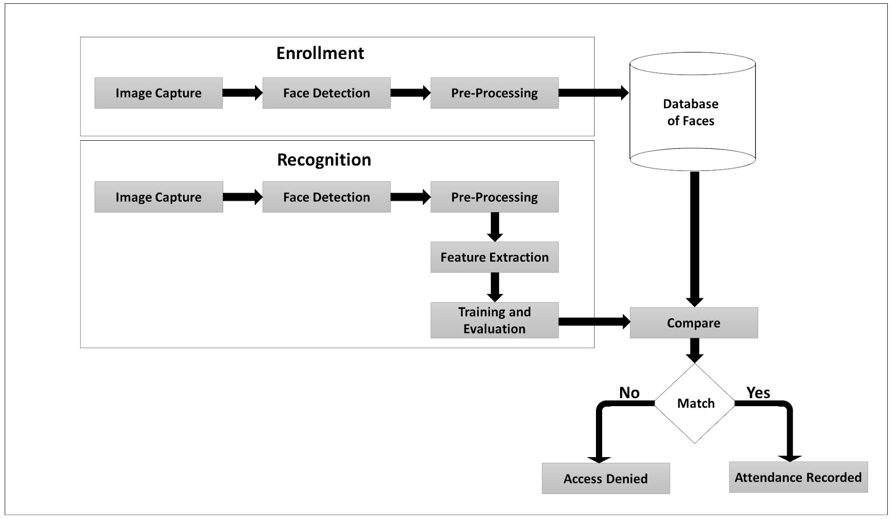
System Block

Slide 11
Time plan :
S.No | TASK ACHIEVED W.R.T TIME | TIME TAKEN
1. | Choosing the Title of project in Technical Domains. | Week-1
2 | Literature survey on project | Week-2
3 | Literature survey and gathering data on existing data and also identifying software and hardware tools for the project. | Week-3
4 | Analyzing the identified problem and proposing the proposing the new system. | Week-4
5 | Library identification for face detection and studying about opencv Haar Casades and Dlib and installing python IDE. | Week-5
6 | Learning about the methods for pre-processed face data set | Week-6

Slide 12
S.No | TASK ACHIEVED W.R.T TIME | TIME TAKEN
7. | Learning about feature extraction and classification | Week-7
8. | Real –time face detection with IP camera. | Week-8
9. | Finding functional and non functional requirements | Week-9
10. | Working on system architecture and flow of project | Week-10
11. | Automatic entry of registered student’s detail in Excel sheet. Attendance report Generation. | Week-11
12. | Testing the system | Week-12

Slide 13
Thank You

